Slide 1
Recent trends and emerging challenges in two-dimensional materials for energy harvesting and storage applications
Introduction
Synthesis of 2D
1/3 dimensions may be nanoscale, 4 types of nanomaterials:
3D: 3 dimensions > nanosize, can be seen by naked eye
2D: 1 dimension nanosized, for eg nanosheets
1D: 2 dimension nanosized, 1D in cm/mm, for eg nanotube
0D: All 3 dimensions nanosized, for eg quantum dot
Some 2D materials: graphene, Xenes, phosphorene, tinene germanene, antimonene, borophene, stanene, silicene
If material with 3D oriented molecular bonds slimmed to 2D, high density of chemically unstable hanging bonds created, rearrangement of shape req to lower surface energy.
Top down synthesis: Mechanical/Liq exfoliation; Bottom down synthesis: CVD, chem. synthesis
Mechanical exfoliation: Sticky tape used to peel layers; low ML yield, low shape/size control
Liq exfoliation: In irganic solvent medium, sonication makes layers separate via tensile stress
Chemical synthesis: interface-mediated growth, nanoparticle fusion into bigger nanosheets, etc. most scalable, low-cost, and flexible approach for large-scale
CVD: heated furnace to pass precursor gases through, where they combine or with a substrate to form thin layer of material; more complex and expensive, but scaleable
Some types of 2D materials
Graphene
1st modern 2D element
1-atom thick covalently bonded hexagonal lattice of C atoms
Highest tensile strength
Unique band structure thus, thermal conductivity
Hexagonal boron nitride
Graphene isomorph: B & N atoms replacing C
Wide-bandgap insulator
Energy applications of 2D materials
Used where bulk materials unsuitable due to change in properties due to reduction in dimensionality
Sensors and transistors
2D FETs - high charge mobility + low BG
H-BN – gate dielectric; Graphene - active channel in transistors by opening bandgap
FET-based sensors from 2D TMDCs can detect range of chemicals in ppm range
Photodetectors
TMDCs: Optical or near-infrared bandgap and good charge transport properties
1 ML of TMDC absorbs ~10% of incident visible light, sufficient for photo detectors
Xenes
Group of Si/Ge/Sn MLs
Graphene isomorph but buckled to certain degree
Epitaxially grown on substrate, not exfoliated
2D TMDCs
Chemical formula MX₂ X=chalcogen (S/Te/Se) M=transition metal (Mo)
Indirect bandgap in bulk
Optoelectronics - direct BG in visible spectrum
Charge transistor - charge mobilities
Nanogenerators
Odd layer TMDCs have piezoelectric properties (absence of inversion symmetry)
If substrate bent at ends, MoS₂ flake expands, causing piezoelectric charges at edges, driving e⁻ flow in an external circuit
Some 2D materials have piezoelectricity + mechanical flexibility; can be used for wearable power generating nanodevices
Battery electrodes
Electrodes for ion batteries require electrical conductivity with large surface area to store high densities of ions
Graphene: higher surface-mass ratio, high conductivity, greater mech strength, flexibility
2D MoS₂: potential electrode as it adopts metallic 1T phase by chemical exfoliation
Phosphorene
Stable layered elemental P allotrope direct bandgap
Ideal for optoelectronic devices-high charge mobility

Slide 2
Observation of single-defect memristor in an MoS2 atomic sheet
Introduction
Preparation
Non-volatile resistive switching: electric field switches resistance states of two-terminal device
High-density information storage computing & reconfigurable systems could use memristor effect but it was believed leakage currents would prevent this for 1nm-thin insulating layers until its discovery in 2D monolayers of transition metal dichalcogenide & hexagonal boron nitride
Metal substitution into S vacancy results in non-volatile change in resistance, supported by computational studies of defect structures
New direction in precision defect engineering, down to a single defect, towards achieving the smallest memristor for applications in ultra-dense memory & neuromorphic computing
MoS₂ monolayers prepared by exfoliation onto Au surfaces & annealed@250ºC for hours in ultrahigh vacuum conditions
Gold STM tip used as top electrode for transport, fixed on surface and moved towards MoS₂ for 2-4 Å for stable contact
Why MoS₂
Formation energies of defect critical to stability & transitions & MoS2 V_{S} & V_{S2} have low EOF of 1.3-2.9eV & 2.9-5.9eV
Density of V_{s} globally altered by annealing in a vacuum or S-rich atmospheres
Enhanced fields allow migration of Au to or from defect, hence stable reversible reaction
Due to layered structure, MoS₂ provides sharp, clean interface to prevent excessive tunnelling current but allows adatoms from electrodes to be absorbed in vacancy sites
Observations
From STS-STM & local transport studies, S vacancy (V_{s}) shows no low-resistance path in its native form until substituted by M⁺ ions (gold) resulting in conducting LDOS, creating low resistance state. After removal of M⁺, defect recovers & restores high resistance
STS shows bandgap less than optical bandgap due to charge transfer from Au substrate & reveal V_{s} don’t enhance tunneling current
Transport meas. reveal tunneling-like I-V phenomena on defect-free zone & repeating transport measurements around defect sites reveal unipolar diode-like behaviour with suppressed charge transport for positive tip biases possibly due to charge accumulation
I–V curves (110M-2.5GΩ) similar to resistive switching observed at V_{s}; Switching can induce new defects & change gold terrace structure
STM shows V_{S2} defect with triangular symmetry, darker contrast & bandgap similar to defect free. V_{S}:V_{S2}=10:1. Repeated measurements trigger switching events and then STM images are taken which show that dark spot is replaced by bright protrusion of ~0.5 Å height
Stability & height of bright spot indicate substituent in vacancy and STS shows non-zero DOS at Fermi level, revealing metallic behavior
DFT-based 1st principle calculations for Au-MoS₂-Au models & Green’s function reveal that gold-ion adsorption into divacancy causes change in I
Subsequent transport measurements with an opposite tip bias trigger a second resistive switching event from low to high resistance

Slide 3
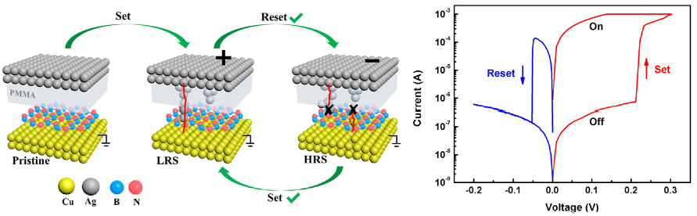
A sub-500 mV monolayer hexagonal boron nitride based memory device
Abstract
Ultrathin 2D nanomaterials, such as graphene and transition metal dichalcogenide (MoS₂, WS₂, TiS₂, TaS₂) have raised increasing attention for RRAM
Ultrathin layer offer low working voltage, ultra-dense integration, high-speed switching
Transfer and lithography-free resistive switching device based on CVD grown h-BN vertically sandwiched by different metallic electrodes reported in this paper
Low operating voltage (<.5V), large on/off ratio, long retention time, excellent flexibility
Tunneling conduction shown in off & on-state current conducts via metallic conducting filaments formed by the substitute of metal ions for lattice vacancies in h-BN
Polymer layer inserted to constrain conducting filament size and block the formation of unwanted filament from Cu bottom, to obtain monolayer h-BN resistive memory device
Experimental
CVD-grown monolayer h-BN bought from 6Carbon Technology
VASP for DFT based on pseudopotential plane-wave method
Observations
Initial high resistance state (HRS) switches to low resistance (LRS) at ~1 V during the 1st sweep, but doesn’t switch back as only partially reset by 3rd sweep
Thin PMMA inactive layer (~ 10 nm) with low processing temp, low cost, high resistivity inserted between top electrode (TE) and h-BN to reduce reset current
Au TE device has higher working current, small on/off ratio (<10). Ag/Cu TE preferable for memory device in light of energy efficiency and data robustness
On measuring Ag/PMMA/Cu structure, +ve sweep shows increase in current at .4V, but negative sweep can’t reset it, thus CuO and PMMA layer affect switching
Fitting of +ve sweeping region shows linear charge transport at LRS & HRS but only LRS is temperature dependent, indicating metallic conducting filament (CF)
RS supported by ABS: B vacancies found mainly at grain boundaries. In simulation, Ag/Cu ions placed near h-BN nanosheet with B vacancy, and after structure optimization calculation, Ag/Cu ion fills boron vacancy on the h-BN layer. Ag dopants cause local deformation of lattice but maintained main morphology of lattice
Ag atoms are isolated and introduce flat bands (localized states) in band gap, leading to a DOS peak at Fermi energy level. By increasing replacement to 6.25%, adjacent Ag begin to interact, bending flat bands in band gap, & at 11.1%, cross the Fermi level, leading to partially-filled band (e⁻ contribute to conductivity)
In devices without PMMA, Ag and Cu ions, from TE and BE respectively, are chemically active to fill B vacancies, thus reset tough for Ag/h-BN/Cu structure
PMMA prevents overgrowth of CF & helps block formation of Cu filaments during reset process, which improves the device yield and switching reliability
Sub-nm thinness & high breaking strain of monolayer h-BN make device highly desirable for flexible nonvolatile memory, functioning perfectly upto 2% strain
Ultra-low working voltage may be useful for unconventional applications like mobile computing or medical devices, using person's body temperature or exercise to meet power needs due to low power consumption, although endurance & switching uniformity not yet sufficient to meet critical requirements for digital memory

Slide 4
Imaging and identification of point defects in PtTe₂
1. PtTe2 film synthesis and characterization
Abstract
Deposition of Pt & Te layers by sputtering and electroplating, annealing of sample at 450 °C for 1.5hr to synthesize PtTe2 film
XPS to confirm successful synthesis of film and assess quality
Raman spectroscopy to study quality of the material synthesized
XRD to examine film crystallinity, indicated by sharp peaks in
SEM images show polycrystalline nature with 200-400nm grains
Type-II Dirac high conductivity semimetal, maybe for spintronics, quantum computing
Point defects can be interstitial, vacancies, self-interstitial, substitutional or a mix
STM to resolve atomic structure/point defects non-destructively & STS to study LDOS
Tip modeled as locally spherical potential well and tunneling current ∝ LDoS, at the position of the tip where it approaches nearest to the surface, assuming that tip wave function has s-orbital character, at distances away from surface, partial density will be zero for localized basis set calculations since the basis orbitals have a finite range
Following Raman spectroscopy, XPS, XRD & SEM, STM and STS done with DFT
2. STM characterization of point defects
Average lattice constant and layer step height of 4.0 and 5.1 Å
According to STM, thickness of flakes ranged 30 - 50 layers
Bigger defects appear less bright, correlated with defect depth
5 types of defects: A,B,C,D,E. A show depressions at both bias voltages, rest display protrusions (depressions) at –ve (+ve) bias
A, C most common, supported by calc. defect formation energy
B are 6 × 6 triangular depression at +ve bias. At -ve bias, defect is characterized by small protrusion of the same triangular area
C are 3 × 3 triangular depression at +ve bias voltage and a small depressed triangle flanked by 3 protruding spots at negative bias
D has hexagonal depressions at +ve bias & completely changes in shape to 3 triangular small inward-pointing depressed triangles
E is 3×3 triangular depression (protrusion) at +ve (-ve) bias voltage and is an antisite defect with Te replacing Pt
4. Electronic structure of PtTe2
Band structures of monolayer (ML), bilayer (BL), and bulk PtTe2 via generalized gradient approximation (GGA) and GGA-1/2, considering spin–orbit coupling (SOC)
Indirect bandgap increases for GGA-1/2, comparable to bandgap of semiconductors, thus ML PtTe2 of interest for electronics like FETs, where effect of dopants is critical
GGA-1/2 “flattens” curvature of VB, pushing CB up in energy; increasing bandgap
Energy level of VBM exceeds CBM, hence overlap of bands, hence semimetal-semiconductor transition occurs due to quantum confinement, showing BL PtTe2 metallic
In ML, BL, bulk PtTe2, p and d orbitals contribute equally to CB, VB originate from p-orbitals compared to d-orbitals, with 10x less contribution from s-orbitals
For Te vacancy, Fermi level is at mid-bandgap; for Pt, in the lower half of the bandgap
Large spin-orbit splitting in defect states, making PtTe2 good for spintronic applications
5. Defect formation energy
3. STS characterization of defect-free area & defects
Formation energies of Te, Pt vacancy calculated by: E_{f}=E_{tot}(defect)-E_{tot}(pristine)+ΣNμ_{i}
When Te-rich, μ_{Te} calculated from Te energy in bulk; when Pt-rich, μ_{Te}=0.5×(μ_{PtTe2}−μ_{Pt})
When Pt-rich, μ_{Pt} calculated from Pt energy in bulk; when Te-rich, μ_{Pt}=μ_{PtTe2}−2×μ_{Pt}
Defect edge shows higher LDoS than flat defect-free area as Te vacancy creates high acceptor density resulting in triangular shape

Slide 5
Rise of the Xenes: From the Synthesis to the
Integration Processes for Electronics and Photonics
1. Xenes Background and State-of-the-Art
2. Electronic properties
Possible to arrange Si and Ge a honeycomb lattice inspite of increased atomic mass wrt C as lattice undergoes buckling. Degree of buckling can be tuned, with low-buckled being stable than high-buckled configurations
Even if freestanding silicene and germanene can exist, no bulk Si, Ge crystals made of silicene and germanene slices to be peeled off
Noble metals like Ag (111) surface substrate to host large no of Xenes: Using molecular beam epitaxy (MBE), silicene, germanene, stanene, borophene, antimonene were successfully realized
Choice of substrate important as it determines properties of deposited Xene, via chemical interaction between X atoms and substrate
Various electronic states makes Xenes appealing for device applications
Advantage of monoelemental crystals: easier characterization independent of environment + provides opportunity of assembling new materials
Challenges of Xenes: large scale deposition with easier, cheaper tools; instability of many Xenes, technology readiness level needs to be raised
Thickness/roughness of 2D materials controlled accurately, thus reliability and uniformity of electronic devices optimizable. Since graphene, 2D material FETs report ON/OFF current ratios >107, subthreshold swing ~62mV/decade
Silicene FETs suffer from limited lifetime (~2 days) at ambient conditions
Study req on transfer process or lithographic step to provide nm resolution
Surface termination can tune optical and electronic properties, improving stability
Group 16 FETs exhibit p-type transport due to presence of H & OH terminations on the nanosheets surface, with high ON/OFF current ratio and hole mobility; act like semi-conductors, making it appealing for electronic applications
4 conditions to provide useful technological knowledge on the Xenes-based FETs
Methods of Xenes synthesis & device fabrication must be scalable to wafer level
Morphology and density of non-idealities in Xenes specified (lattice distortions)
FET size small enough to be compatible with integration density requirements
Information about yield, device-to-device variability, reliability & stability provided
Future challenge: Improving performance; extend fabrication methods to all Xenes
3. Photonics Applications
4. Challenges and Advances in Xene Processing
Novel optical responses from material engineering, controlling thickness or morphology manipulation and realization of 2D heterostructures
Calculated optical properties of 2D silicene revealed spectral features absorbance like graphene due to linear bands & Dirac cones at low optical frequencies, interband transitions near critical points higher photon energies
In IR range of 2D silicon, Dirac-like absorption resembling silicene (theoretical)
Can exploit non-trivial topological state in plasmonic optical response in ultrathin tin nanosheets. QSH insulator state expected in stanene/silicone
Combining optical + electronic properties key for photonic devices
Non-linear optical properties: nonlinear photodiode, Q-switching, modulators
Xenes intergration adds complexity in design due limitations in synthesis
For complex device architectures, control of Xene quality must be improved
Further investigations req. in compatibility with standard nanofabrication tools
Establish patterning/etching protocols assessing stability & response of various Xenes to chemicals and physical agents, like annealing, etching, deposition
In-situ encapsulation of silicene via Al₂O₃ capping layer protects silicene in ambient condition & enables electrostatic gating of Xene-based FET channels
Capping layer engineering needs to be proposed, exploiting novel materials
Transfer of Xene (native->arbitrary substrates) needed; depends on crystal orientation
Novel methods needed where a Xene layer forming heterostructure is considered as sacrificial aiming at improving the reliability of the transfer process

Slide 6
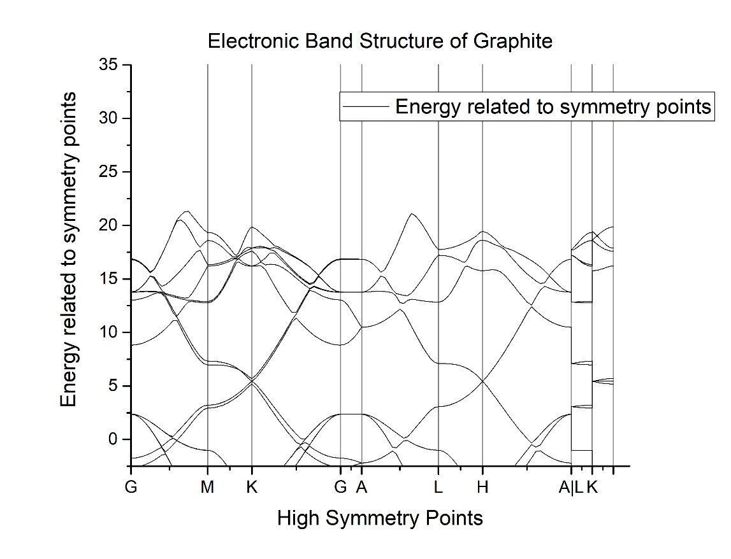
Progress on learning modelling softwares
1. Quantum Espresso
Setup of Quantum Espresso including necessary libraries
Writing input SCF files
Generating input SCF files from CIF files online
Optimization of wavefunction cutoff
Optimization of K points via NxNxN convergence method
Relax and Variable cell relaxation calculation
Calculation of bulk modulus
Calculating density of states and integrated density of states and plotting DOS vs Energy
Plotting Electronic Band Structure
Calculation of band gap
Basic quantum physics knowledge and equations of band structure

